Slide 1
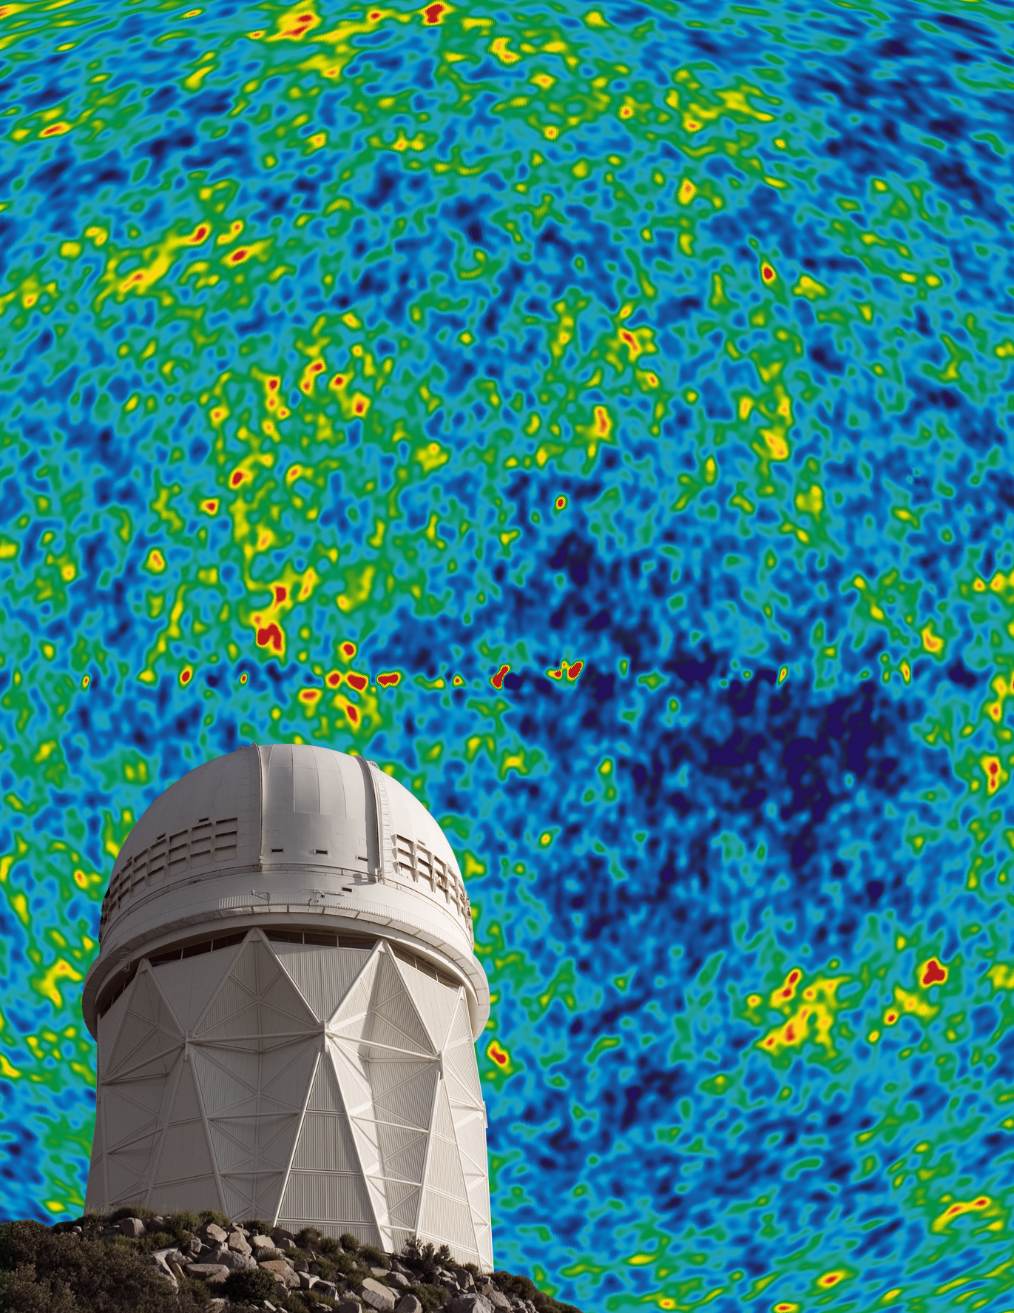
BigBOSS:
Ground-Based
Dark Energy Experiment
Francisco Prada & Marco Azzaro
(Santiago Becerril, Justo Sánchez,
Isaac Morales, Antonio Montero-Dorta)
IAA-CSIC
Granada, 26 May 2011
http://bigboss.lbl.gov

Slide 3
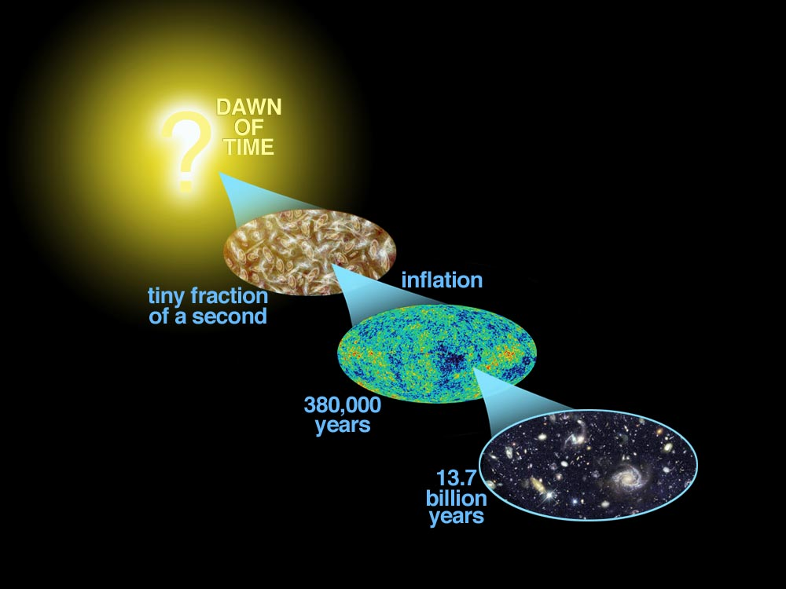
Why map the sky?
Test the standard cosmological model
Nature of Dark Matter and Dark Energy
remains unknown!
Deceleration
from gravity
Acceleration!
Dark energy?
today
http://bigboss.lbl.gov

Slide 4
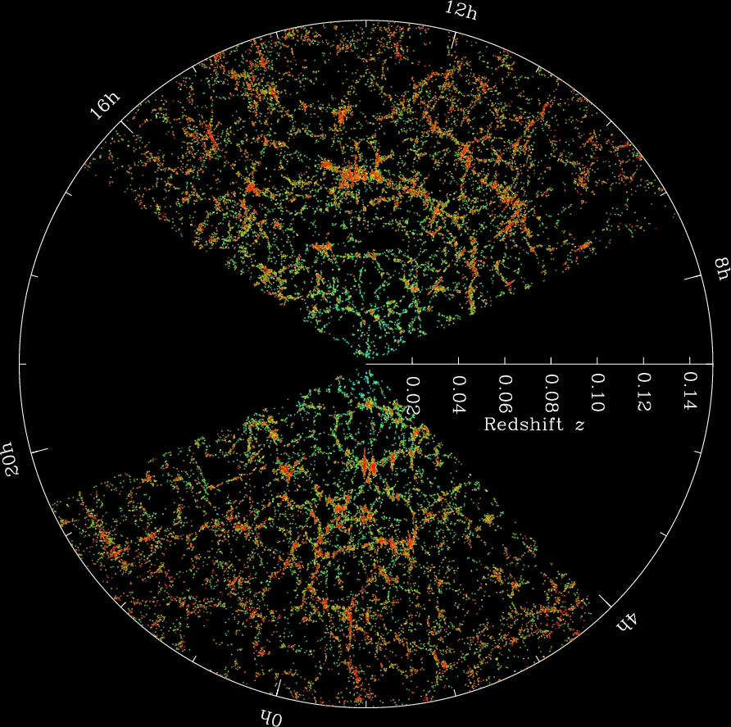
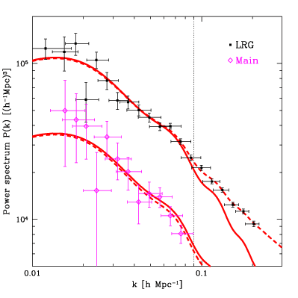
Why map the sky?
Turn-over depends upon horizon size at matter-radiation equality
Today’s maps of the Universe
SDSS galaxy redshift map
Sound horizon scale at recombination (BAO)
What did we learn?
Grav. growth explains CMB fluctuations → galaxy
Galaxy halo occupation of dark matter halos (HOD)
Nonlinear growth
http://bigboss.lbl.gov

Slide 5
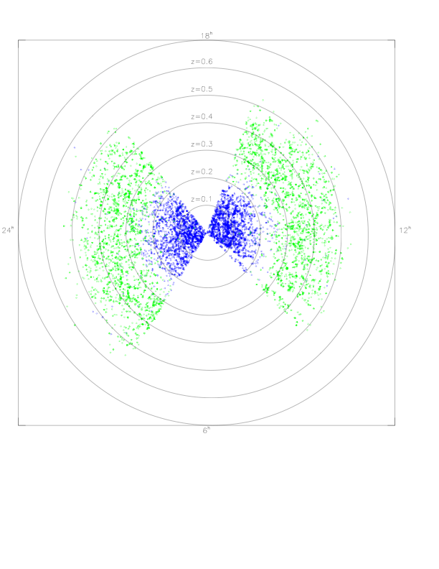
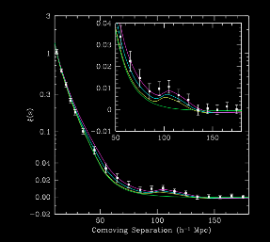
BAO from 3-D maps: SDSS
First detection
SDSS luminous red galaxies (LRGs)
Sparse sampled at 10⁻⁴ galaxies/Mpc³
47,000 galaxies over 4000 deg² by 2004
80,000 galaxies over 8000 deg² by July 2008
BAO peak
Eisenstein et al 2005
5
http://bigboss.lbl.gov

Slide 6
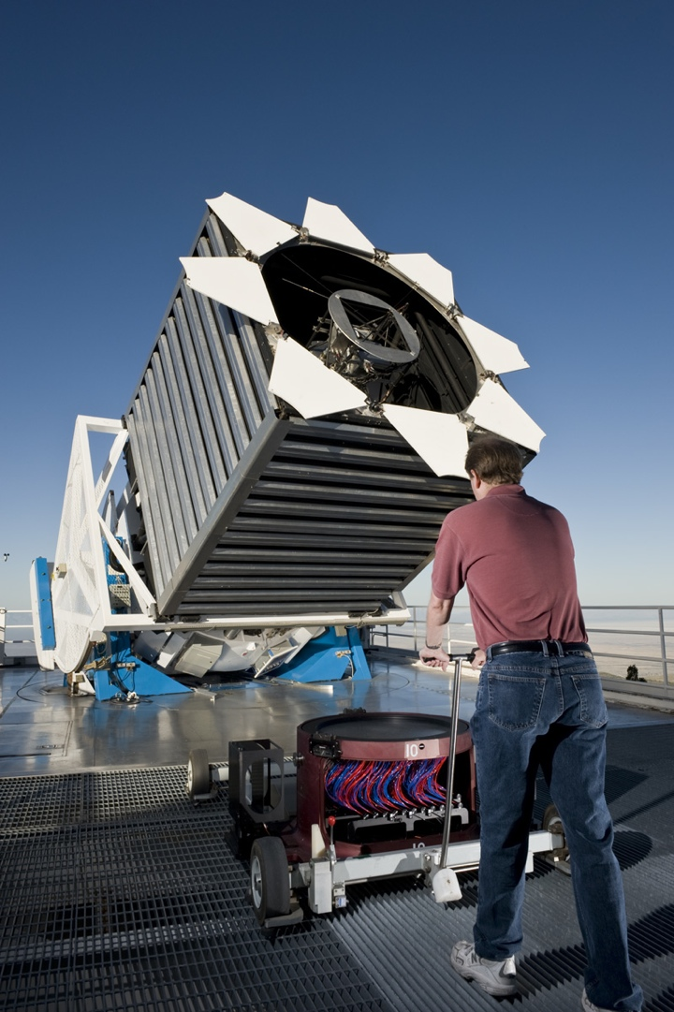
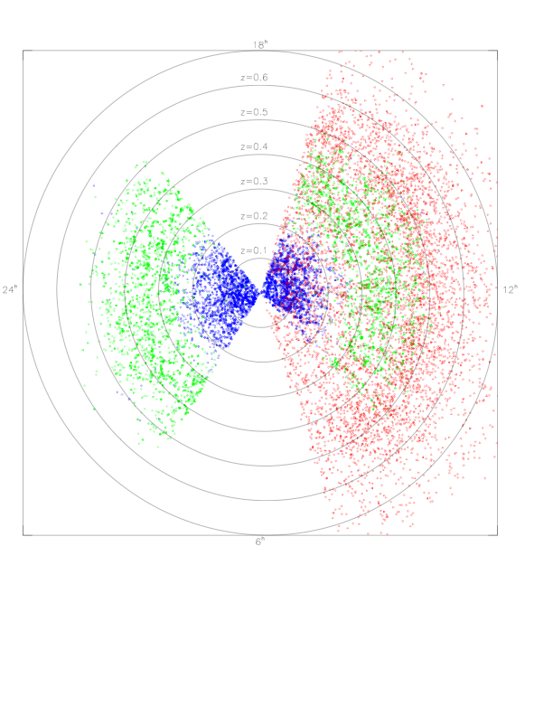
BOSS == Baryon Oscillation Spectroscopic Survey
SDSS-III
Two simultaneous spectroscopic surveys from 2009-2014
➙ BAO from 1.5 million galaxies at z=0.3, 0.6
➙ BAO from 160,000 QSOs at 2.2<z<3
SDSS main galaxy survey
~1 million galaxies
Too little volume for BAO
SDSS luminous red galaxies (LRGs)
80,000 galaxies
Sparse sampled at 10⁻⁴ galaxies/(h⁻¹Mpc)³
BOSS red galaxies
10,000 deg²
5x sample density
2x volume
Turn this photo-z map ➙ 3-D map
http://bigboss.lbl.gov

Slide 7
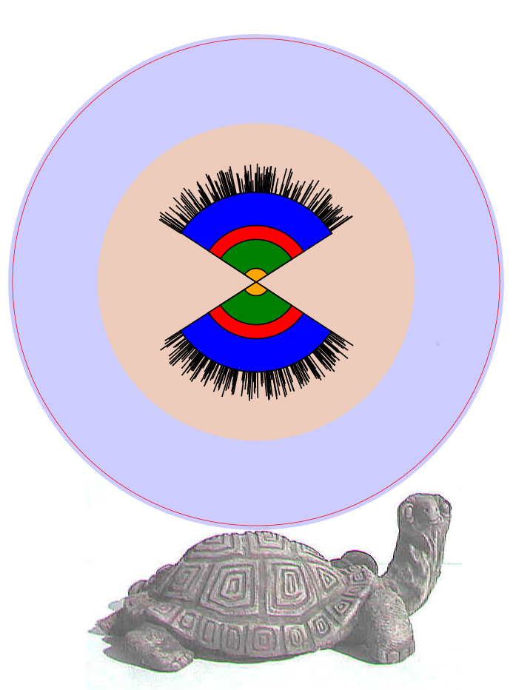
BigBOSS Design Philosophy
➫ Optimize for z’s only
➫ Simple design ⇔ high throughput
➫ “Full-sky”
David Schlegel, Madrid, 20 Sep 2010
7
http://bigboss.lbl.gov

Slide 8
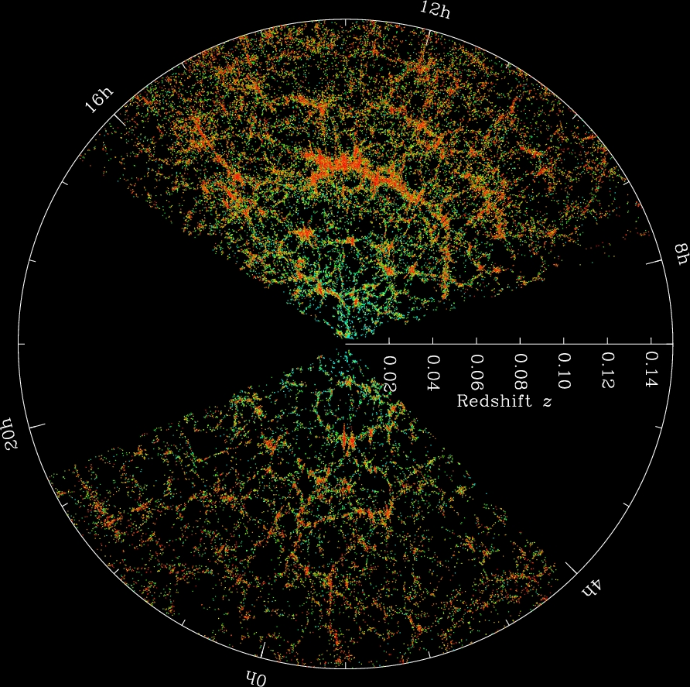
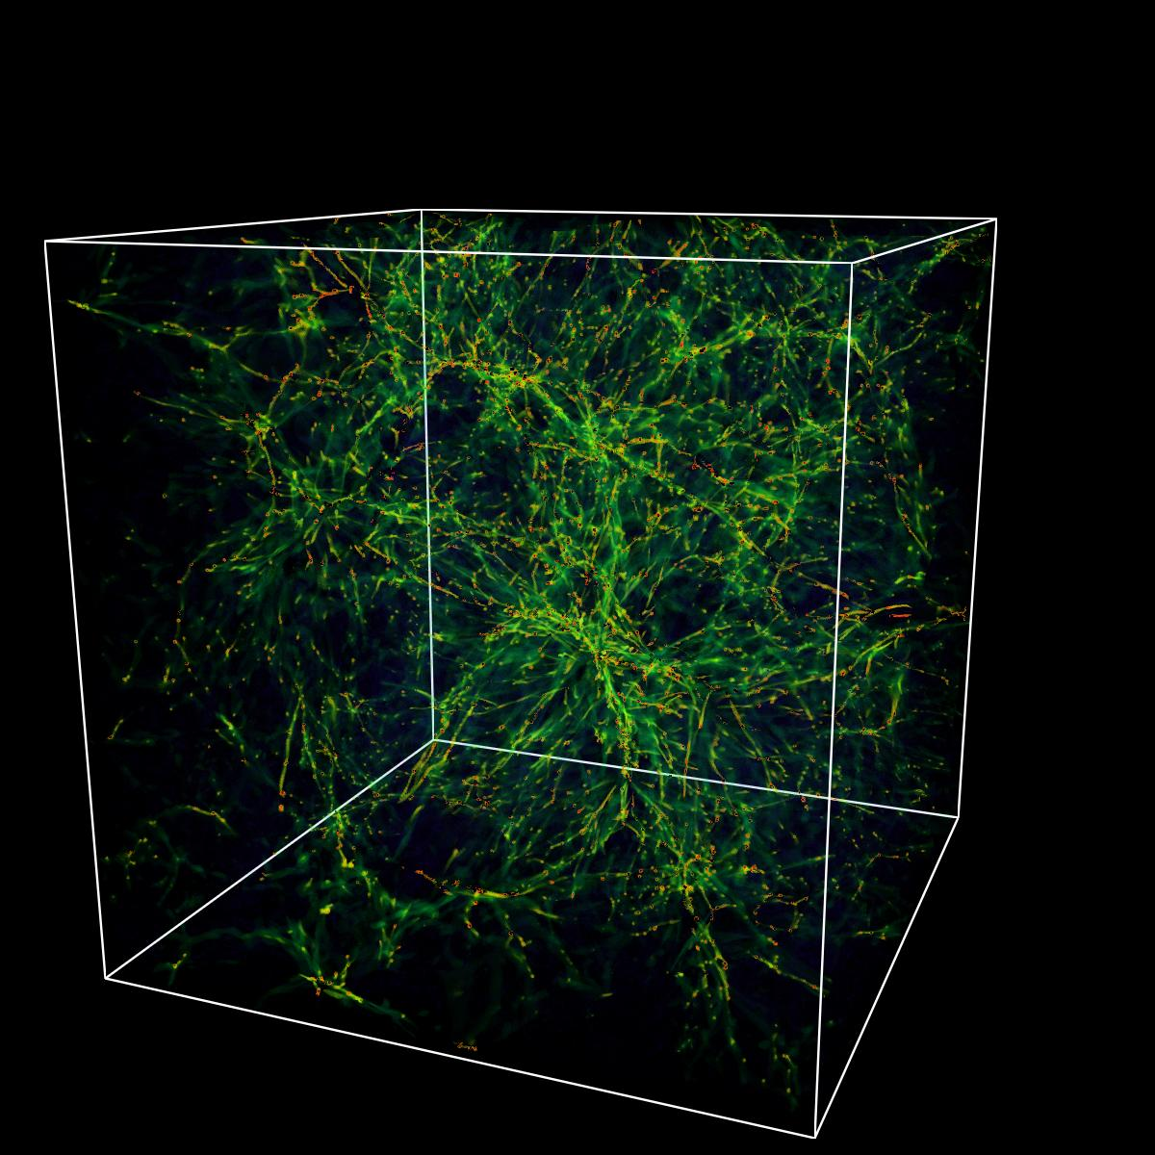
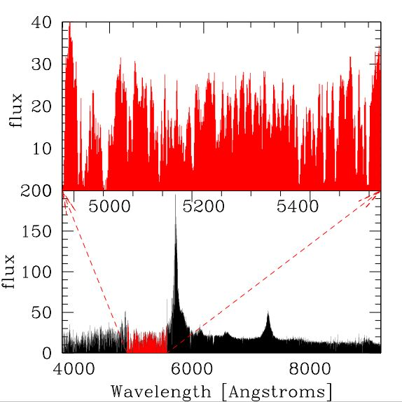
Science Goals:
BAO from 40+ million redshifts
Simultaneous spectroscopic surveys from 2017-2022
➙ BAO from 40 million galaxies at 0 < z < 2
➙ BAO from 1 million QSOs at 2<z<3.5
Galaxy map
QSOs as back-light to hydrogen gas
http://bigboss.lbl.gov

Slide 9
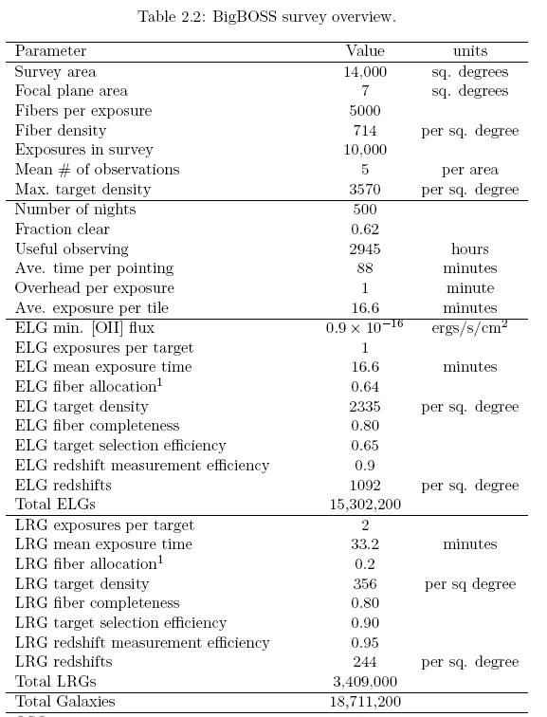

Slide 11
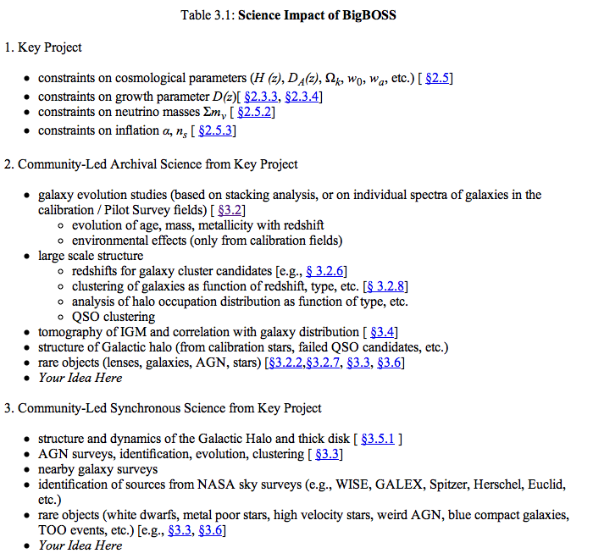
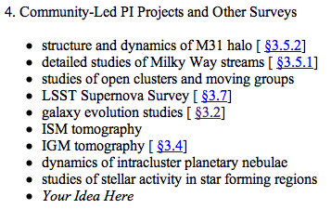

Slide 12
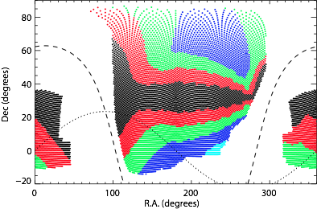
Sky coverage:
Northern survey 14,000 deg²
David Schlegel, Madrid, 20 Sep 2010
http://bigboss.lbl.gov

Slide 13
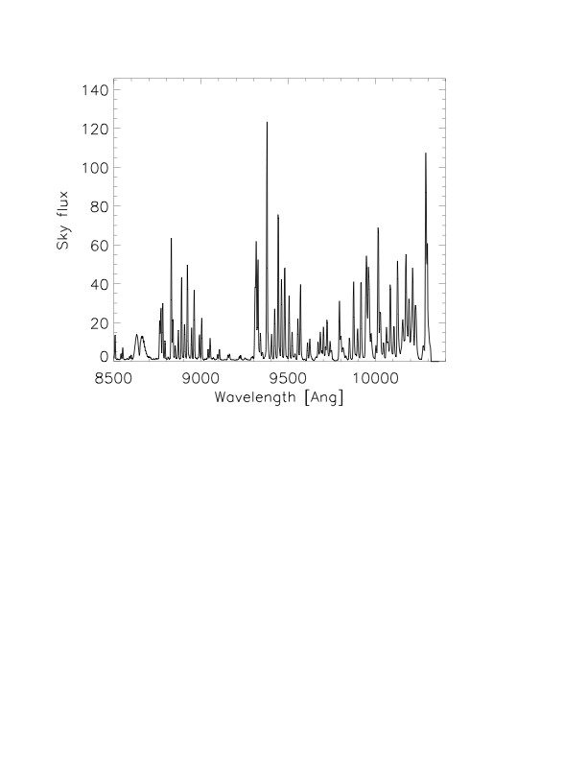
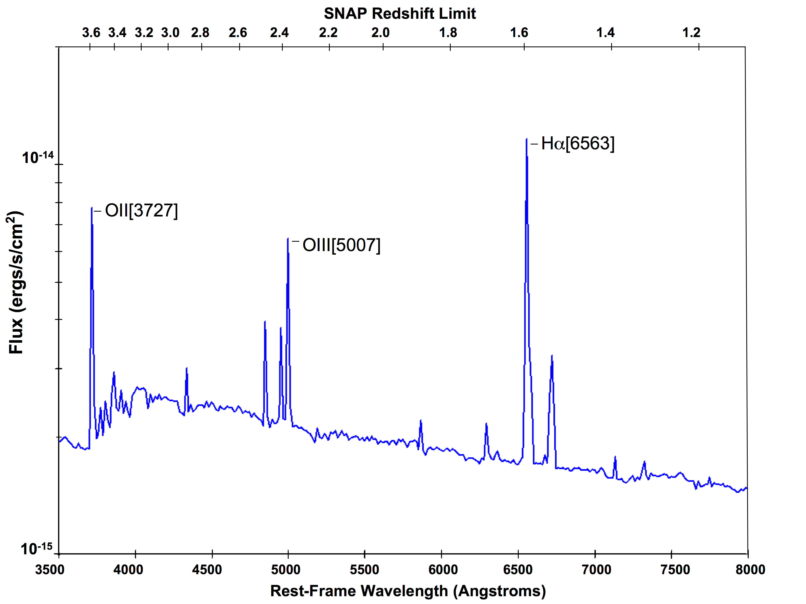
Pilot data from DEEP2
Emission-line galaxies 0.7<z<2
The trick?
At z~1 galaxies are forming stars + strong [O II] emission lines
Detect these lines between the airglow
Galaxy spectrum z~1
Night sky spectrum
David Schlegel, Madrid, 20 Sep 2010
13
http://bigboss.lbl.gov

Slide 14
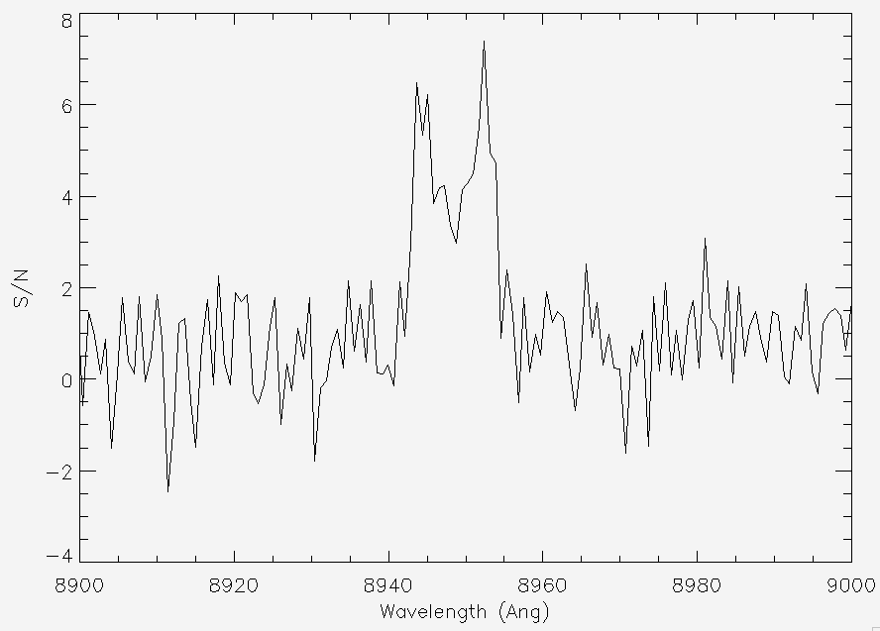
Instrument:
Spectrographs x 10
Instrument designed to be a “BAO spectrograph”
Detect emission-line galaxies at z→1.7
Observed
Spectrum
Sky-Subtracted
Spectrum
λ
[OII]λ3726, λ3729 @ z=1.4
Resolution > 5000
➜ Split [O II] line
➜ Work between sky lines
Same as DEEP2 survey
David Schlegel, Madrid, 20 Sep 2010
http://bigboss.lbl.gov

Slide 15
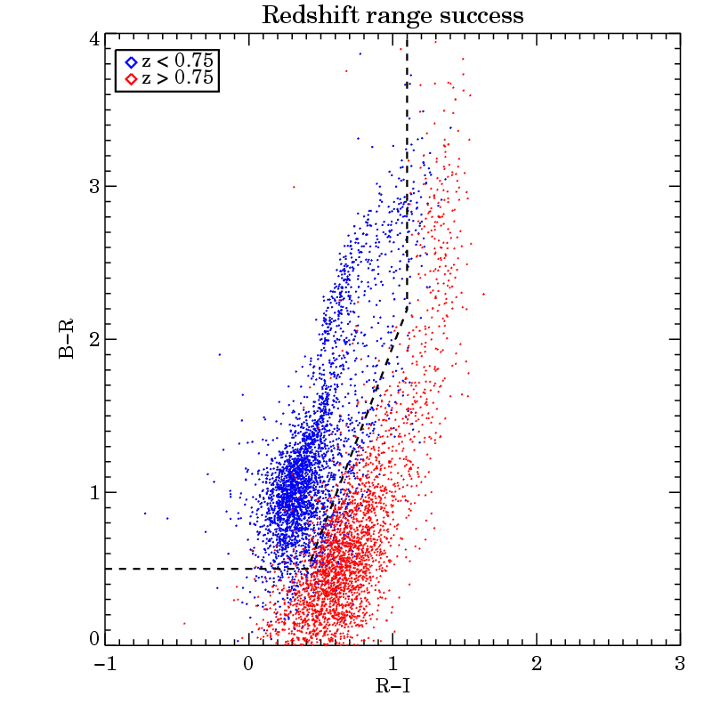
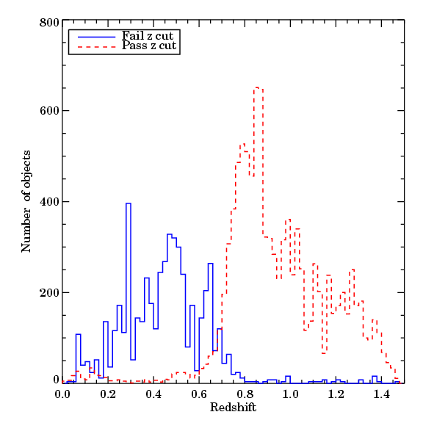
Targets:
Emission-line galaxies 0.7<z<2
DEEP2 + zCOSMOS surveys demonstrate targeting [O II] emitters
No need for photo-z’s
z<0.7
z>0.7
David Schlegel, Madrid, 20 Sep 2010
http://bigboss.lbl.gov

Slide 16
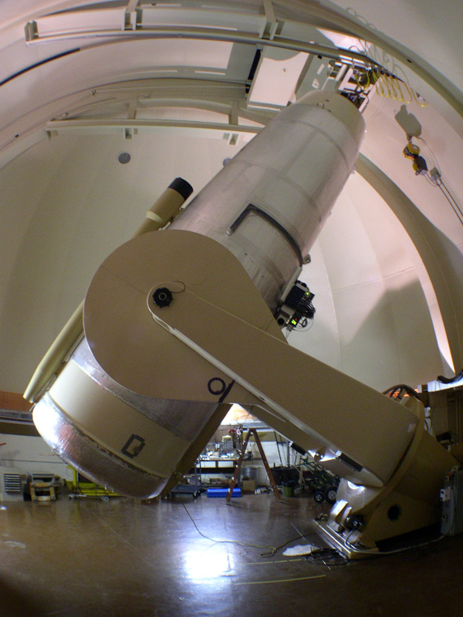
Targets:
Emission-line galaxies 0.7<z<2
Palomar Transient Factory
g+r imaging (3 hours exposure)
i-band from Pan-STARRS1
David Schlegel, Madrid, 20 Sep 2010
http://bigboss.lbl.gov

Slide 26
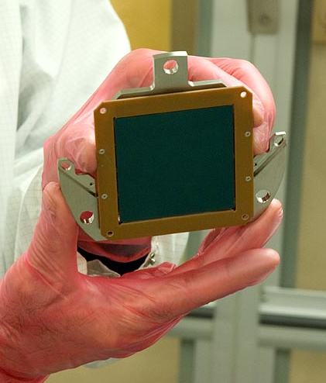
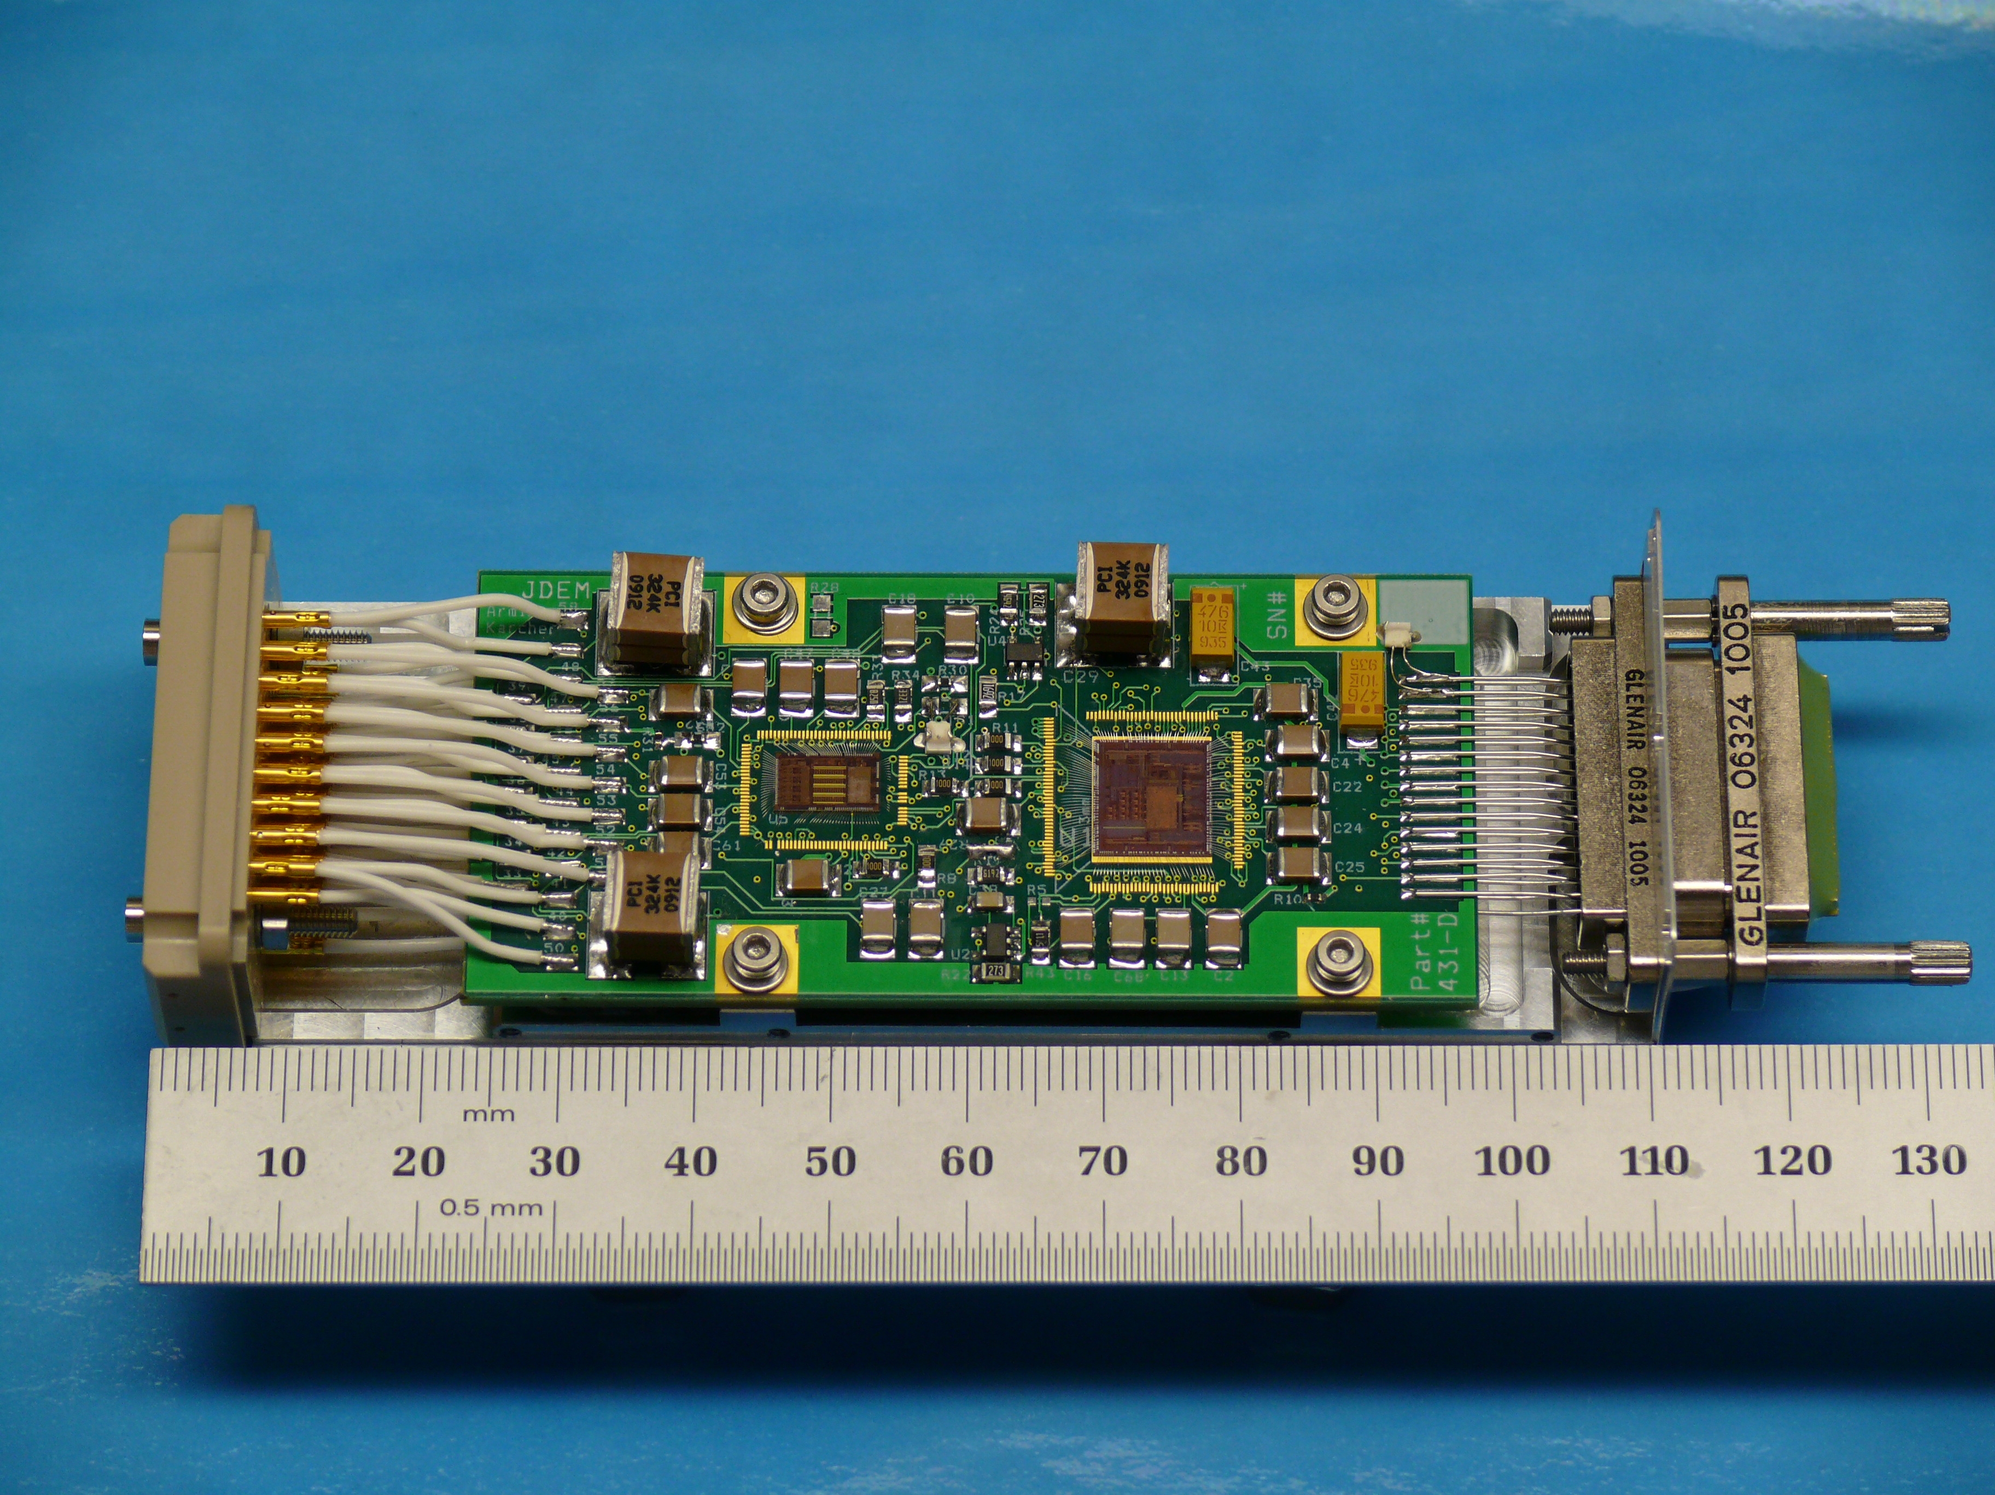
Instrument:
CCDs + electronics
Lawrence Berkeley National Lab (LBNL):
Red-sensitive CCDs developed for SNAP/JDEM
4k x 4k devices in current use for BOSS
Integrated circuit electronics
Compact, in cryo, also developed for SNAP/JDEM satellite
http://bigboss.lbl.gov

Slide 27
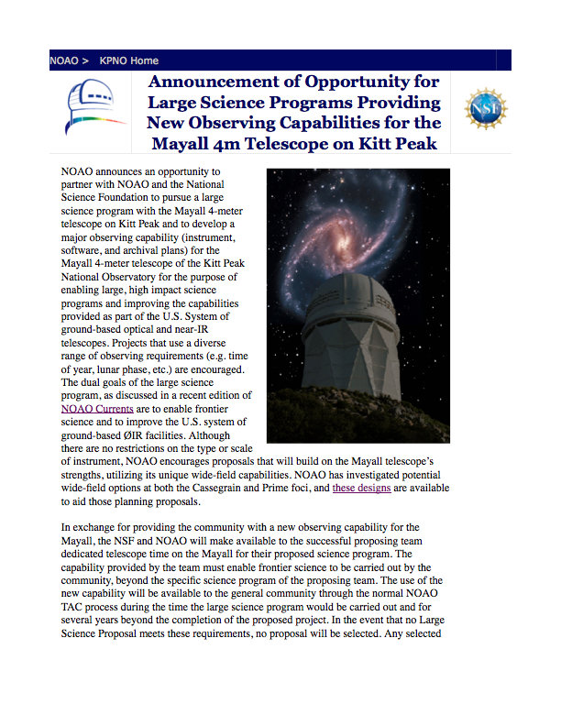
Status:
Telescope call on Nov 18th, 2009
BigBOSS Proposal submitted
on October 2010
Favorable Review by NOAO
on February 2011
DOE Review on Nov. 2011
27
http://bigboss.lbl.gov

Slide 28
Status:
Budget & schedule
“First light” 2017 at Kitt Peak
Budget: $100M
Current Conceptual Design work:
Fiber positioners (USTC/China, IAA Granada/Spain, LBNL/USA)
Focal plane (IAA Granada/Spain)
Fiber testing (IEU/Korea)
Spectrographs, cyrogenics (Marseille + Saclay/France)
Extreme silicon (Berkeley Lab/U.S.A.)
Collaboration:
Project led by LBNL at Berkeley, USA + many other institutions form USA, France, UK, China and Spain (IAA, IFT, IAC, IC-UB, OA-UV)
http://bigboss.lbl.gov

Slide 29
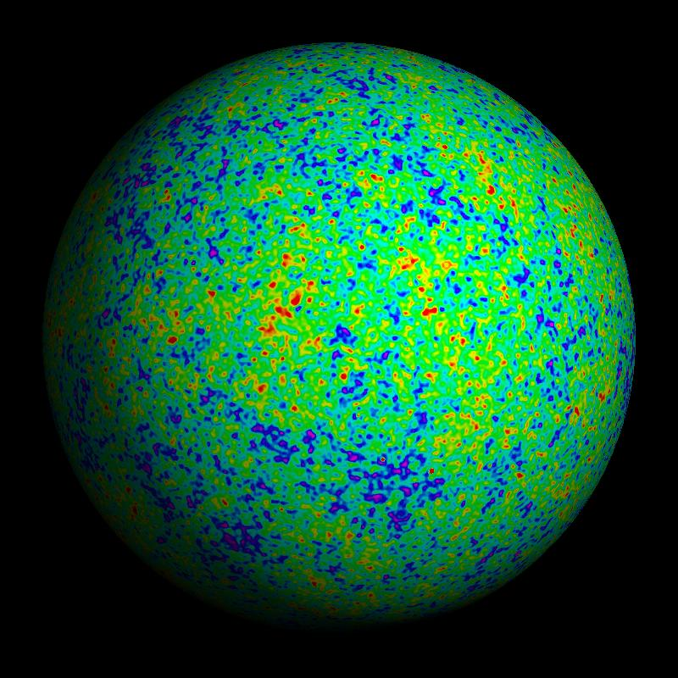
Why map the sky?
Baryon Acoustic Oscillations (BAO)
Sound waves traveled 500 million light years in the plasma of the early Universe, then abruptly stopped.
We can use this as a “standard ruler”
One wave
WMAP
Many superposed
waves
Map of Universe at 400,000 years (CMB)
http://bigboss.lbl.gov

Slide 30
Why map the sky?
Precision dark energy probe from BAO scale
We can use this as a “standard ruler”
These fluctuations of 1 part in 10⁵ gravitationally grow into
... these ~unity fluctuations today
standard ruler
Universe at 300,000 years old (CMB)
Universe today (galaxy map)
http://bigboss.lbl.gov

Slide 31
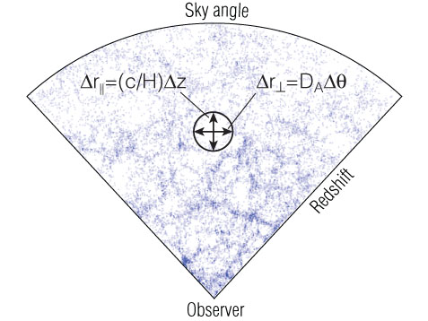
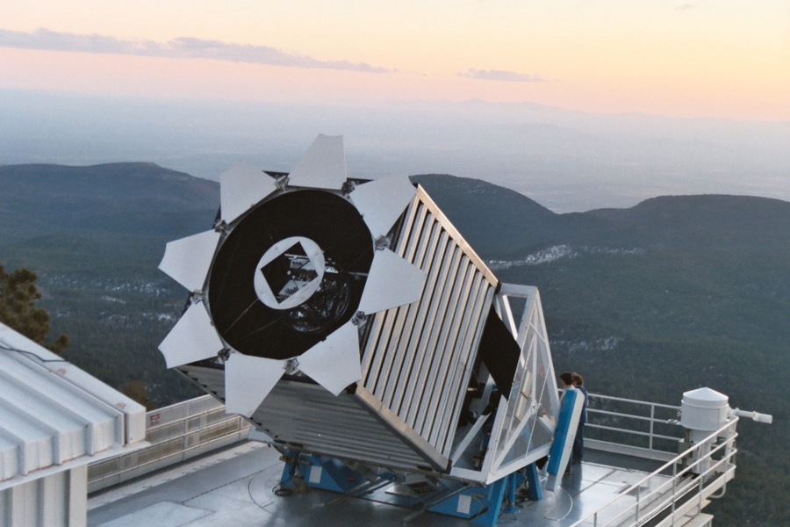
BAO and dark energy
Important note: We need only sparsely sample these tracers
Requirement: Sample linear modes at 100 h⁻¹Mpc
What we like...
Like supernovae, a geometrical probe of the expansion rate (and dark energy)
The acoustic oscillation scale depends on the sound speed and the propagation time
Anchored at recombination (z=1088) by the CMB
Orientation of ruler provides two different probes
Transverse rulers probes DA(z)
Line of sight rulers probe H(z)
These depend on the matter-to-radiation ratio (Ω_{m}h²) and the baryon-to-photon ratio (Ω_{b}h²)
Only need to make 3D maps (angles + redshifts)
What we don’t like...
Ruler is inconveniently long → 150 Mpc = 450 million light years
Statistical measure of a small signal → Requires mapping millions of objects
http://bigboss.lbl.gov

